Slide 1

NoaNodz
By: Toronto Keyboard Maple Leaf Warriors

Slide 2

Project Goal
Easy Music Sharing
Central Music Hub for all websites
Used in conjunction with your favorite streaming service

Slide 3
Menu Bar

Slide 4
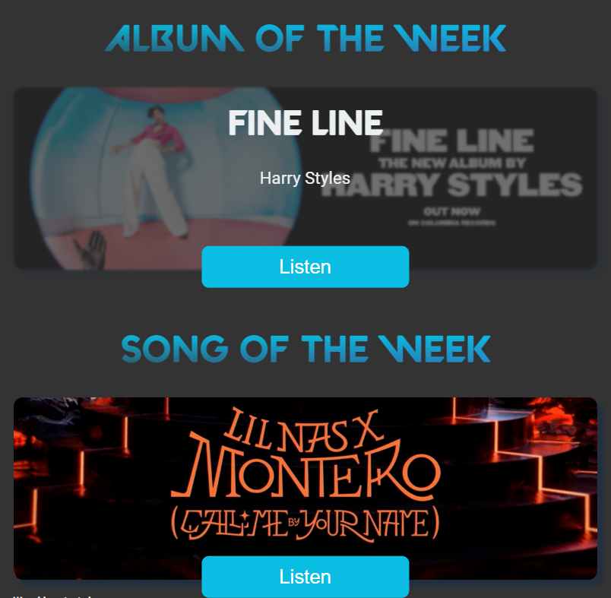
Home Page

Slide 5
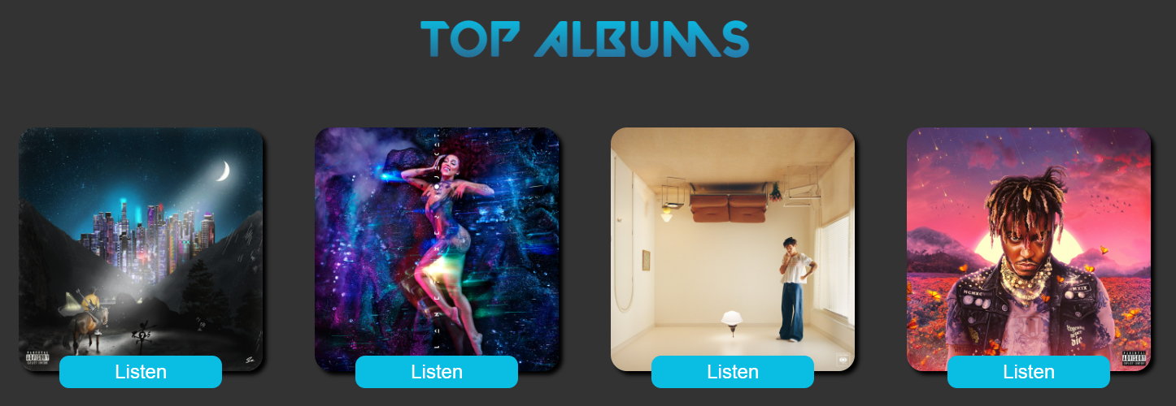
Album/Song Page

Slide 6
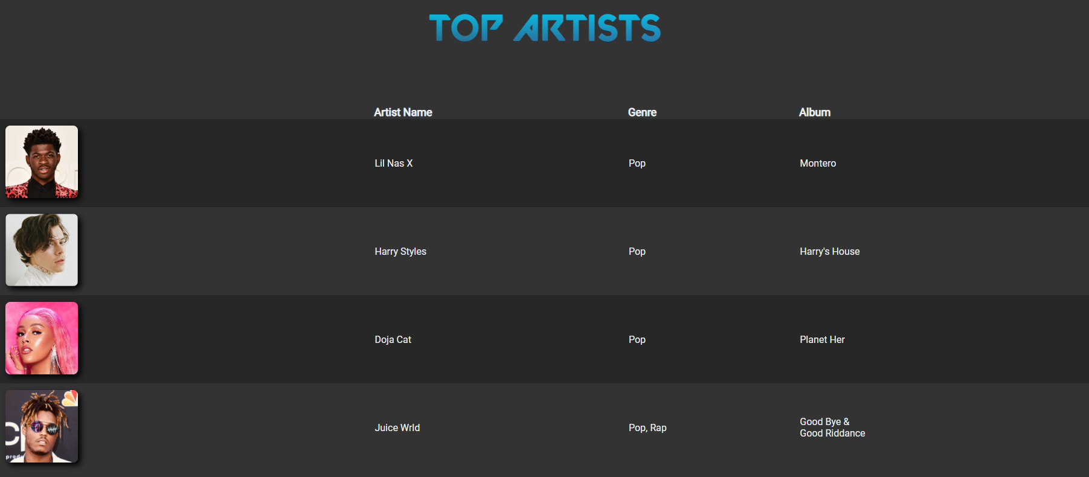
Artist Page

Slide 7
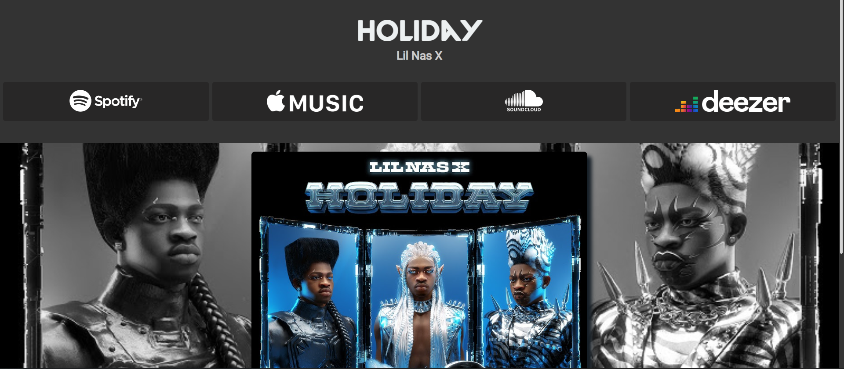
Individual Songs/Albums

Slide 8
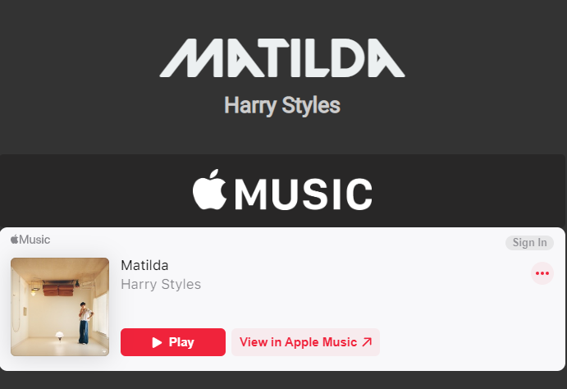
Embedded Pages

Slide 9
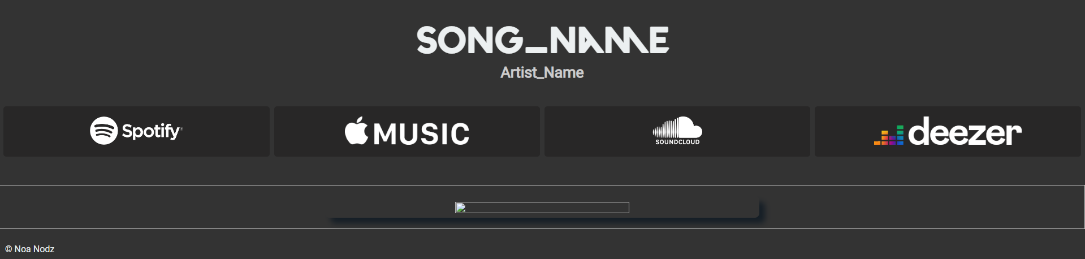
Template Page

